Slide 1
Introduction to Parallel Computing
Jemmy Hu
HPC Consultant
SHARCNET/Compute Canada
University of Waterloo
November 23, 2018

Slide 2
Contents
What is Parallel Computing?
Why use Parallel Computing?
Parallel Computer Memory Architectures
Parallel Computing
# problem faced
# hardware
# software model
- MPI
- OpenMP
Demo

Slide 3
What is Parallel Computing?
In general, software has been written for serial computation:
To be run on a single computer having a single Central Processing Unit (CPU);
A problem is broken into a discrete series of instructions.
Instructions are executed one after another.
Only one instruction may execute at any moment in time.

Slide 4
In the simplest sense, parallel computing is the simultaneous use of multiple compute resources to solve a computational problem.
To be run using multiple CPUs
A problem is broken into discrete parts that can be solved concurrently
Each part is further broken down to a series of instructions
Instructions from each part execute simultaneously on different CPUs

Slide 5
Why use Parallel Computing?
The primary reasons for using parallel computing:
Run faster - short wall clock time (runtime)
Solve larger problems
Provide concurrency (do multiple things at the same time)
Other reasons might include:
Taking advantage of non-local resources - using available compute resources on a wide area network, or even the Internet when local compute resources are scarce.
Overcoming memory constraints - single computers have very finite memory resources. For large problems, using the memories of multiple computers may overcome this obstacle.

Slide 6
Parallel Computer Memory Architectures
Distributed Memory (Beowulf Cluster)
A communication network to connect inter-processor memory
Processors have their own local memory. Memory addresses in one processor do not map to another processor, so there is no concept of global address space across all processors.
When a processor needs access to data in another processor, it is usually the task of the programmer to explicitly define how and when data is communicated. Synchronization between tasks is likewise the programmer's responsibility.
The network "fabric" used for data transfer varies widely, though it can be as simple as Ethernet.

Slide 7
Shared Memory (SMP solution)
Shared memory parallel computers vary widely, but generally have in common the ability for all processors to access all memory as global address space.
Multiple processors can operate independently but share the same memory resources.
Changes in a memory location effected by one processor are visible to all other processors.
Shared memory machines can be divided into two main classes based upon memory access times: UMA and NUMA.

Slide 8
Hybrid Distributed-Shared Memory (Cluster solution)
Employ both shared and distributed memory architectures
The shared memory component is usually a cache coherent SMP machine. Processors on a given SMP can address that machine's memory as global.
The distributed memory component is the networking of multiple SMPs. SMPs know only about their own memory - not the memory on another SMP. Therefore, network communications are required to move data from one SMP to another.
This type of memory architecture will continue to increase at the high end of computing for the foreseeable future, plus accelerators (GPU, FPGA, etc.)

Slide 9
Parallel Computing – problem faced
Hardware
in order to facilitate processors working together they must be able to communicate
interconnect hardware is the key
High throughput, Low latency
communication over any kind of network is still a challenge compared to bus speed
Software
parallel algorithms are actually fairly well understood
the realization of algorithms in software is non-trivial
compilers
automated parallelism is difficult
design
portability and power are typically at odds with each other

Slide 10
Hardware: Graham cluster

Slide 11
Essentials: Graham cluster
Number of CPU cores: 33,448
Number of nodes: 1043
32 cpu cores per node
Between 128 and 3072 GB of RAM per node
Number of NVIDIA P100 GPUs: 320
Networking: EDR (cpu nodes) and FDR (GPU and cloud nodes) InfiniBand

Slide 12
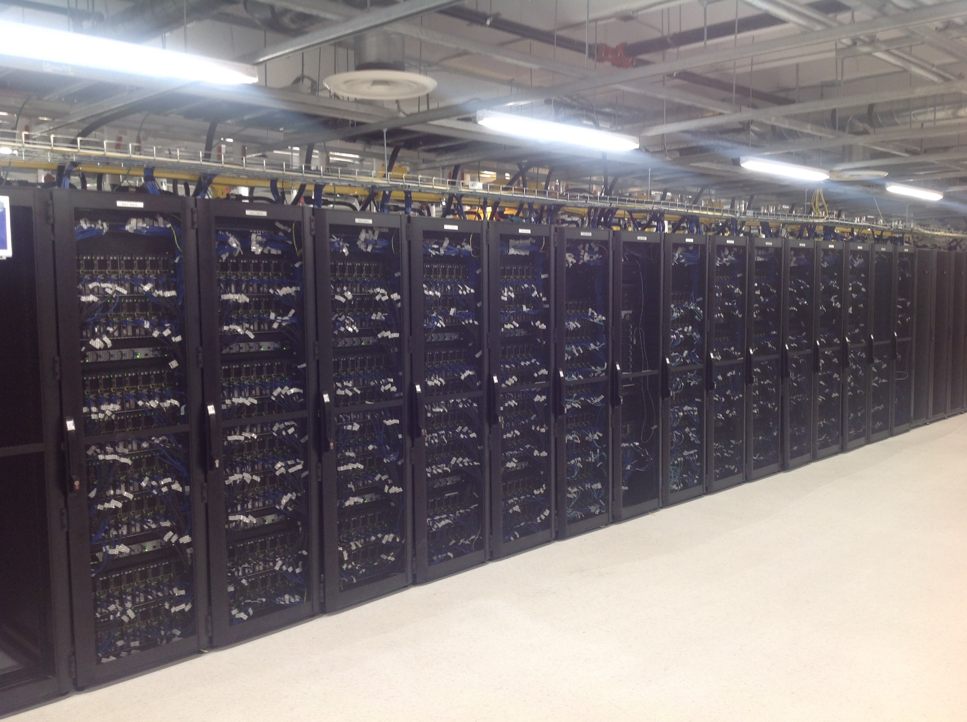

Slide 13
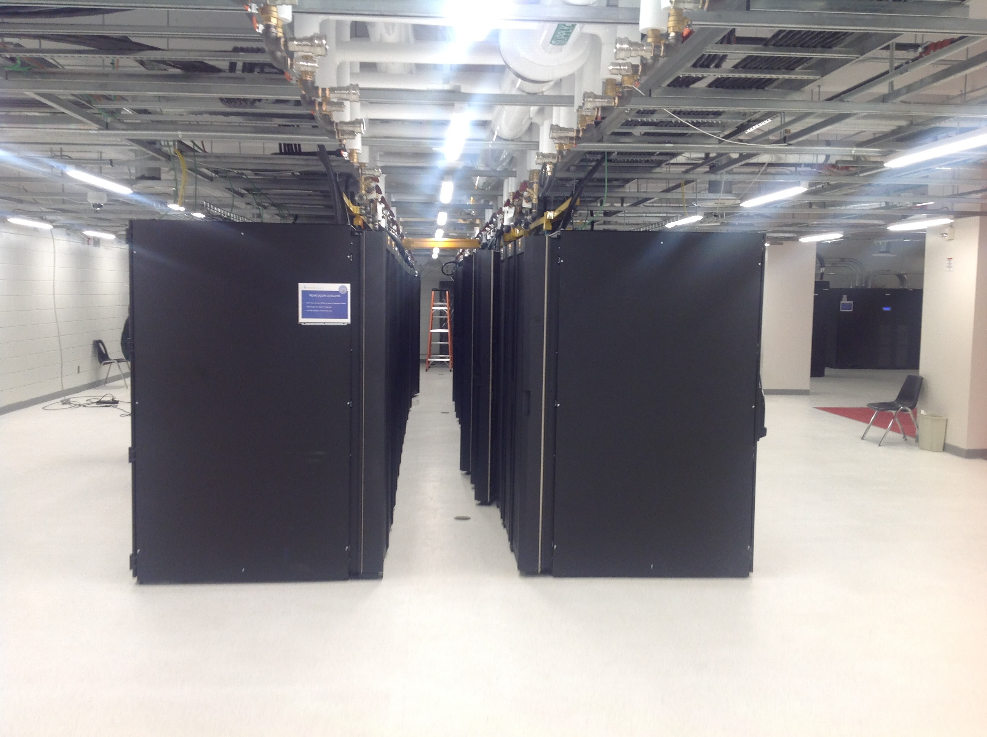

Slide 14
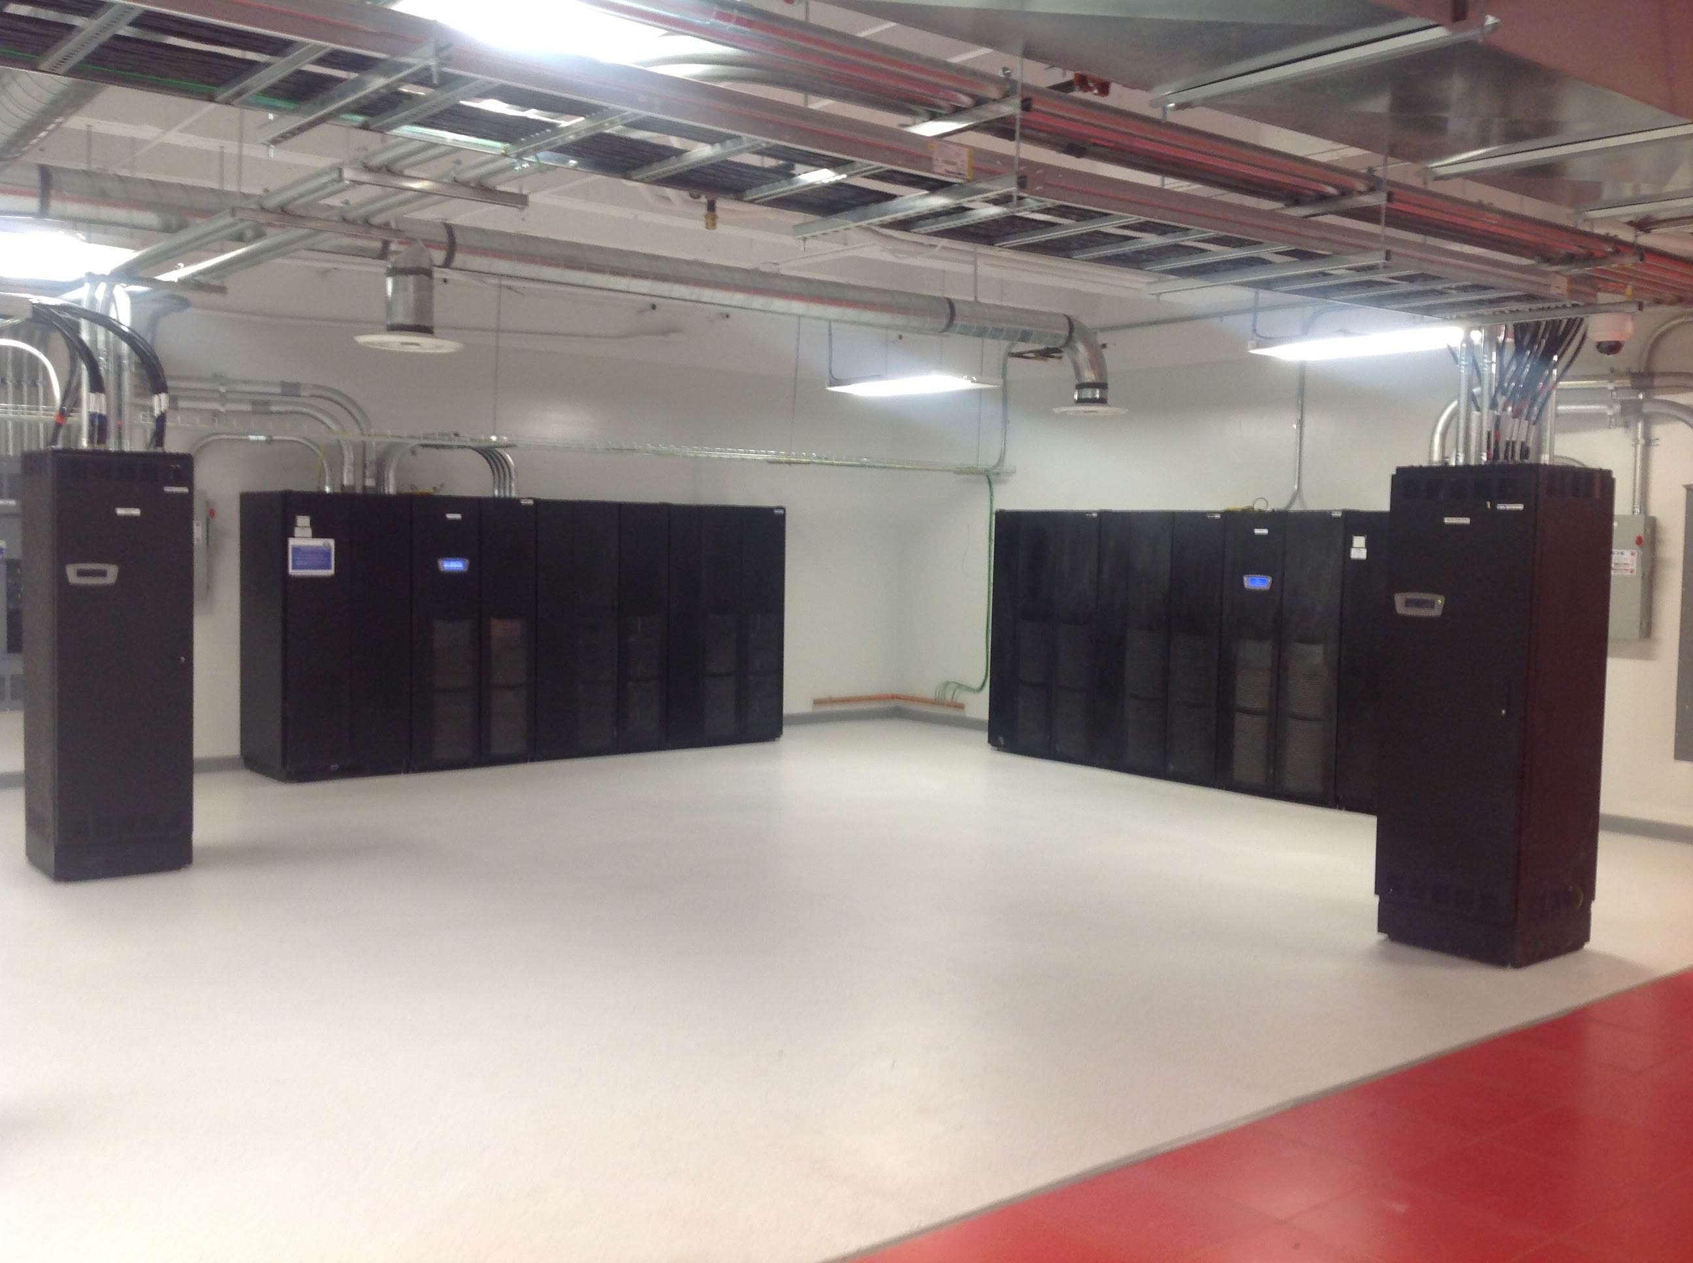

Slide 15
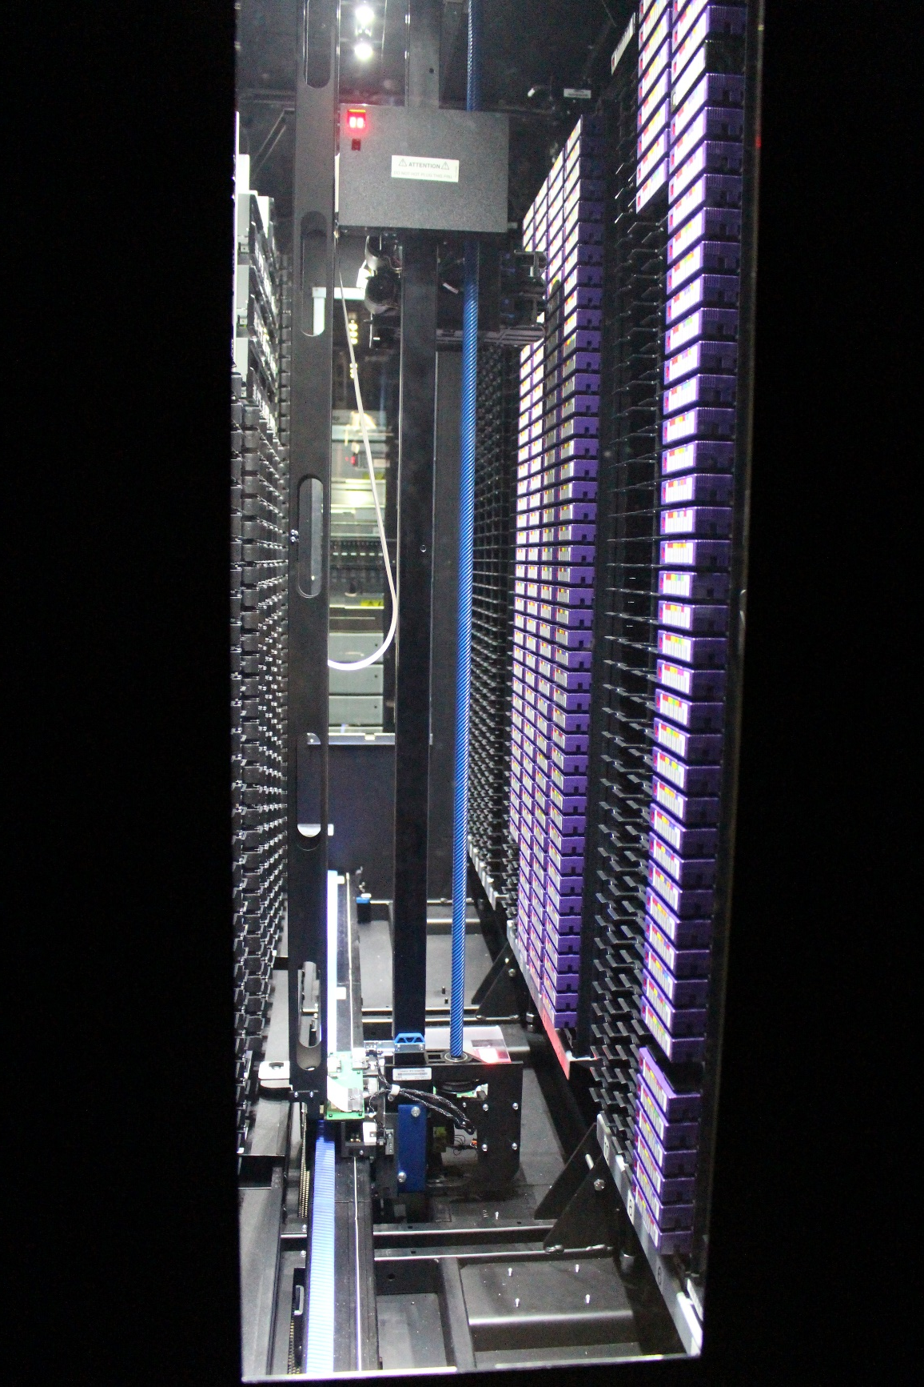
Tape Machine

Slide 16
Software Programming Model
Distributed memory systems
For processors to share data, the programmer must explicitly arrange for communication -“Message Passing”
Message passing libraries:
MPI (“Message Passing Interface”)
PVM (“Parallel Virtual Machine”)
Shared memory systems
“Thread” based programming (pthread, …)
Compiler directives (OpenMP)
Can also do explicit message passing, of course

Slide 18
MPI
Message Passing Interface
http://www.mpi-forum.org/

Slide 19
MPI: What is it?
Library providing message passing support for parallel/distributed applications
not a language: collection of subroutines (Fortran), functions/macros (C)
explicit communication between processes
Advantages
standardized
scalability generally good
memory is local to a process (debugging/performance)
Disadvantages
more complex than implicit techniques
communication overhead

Slide 20
Message passing Model
The message passing model demonstrates the following characteristics:
A set of tasks that use their own local memory during computation. multiple tasks can reside on the same physical machine as well across an arbitrary number of machines.
Tasks exchange data through communications by sending and receiving messages.
Data transfer usually requires cooperative operations to be performed by each process. For example, a send operation must have a matching receive operation.

Slide 21
MPI Programming Basics
Basic functionality, the ability to:
Start Processes
Send Messages
Receive Messages
Synchronize
Core Functions
MPI_Init()
MPI_Finalize()
MPI_Comm_rank()
MPI_Comm_size()
MPI_Send()
MPI_Recv()
MPI_BCAST()
MPI_REDUCE()

Slide 22
MPI library
Include MPI header file
C
include “mpi.h”
– C++
include “mpiCC.h” or “mpi++.h”
Fortran
include “mpif.h”
Compile with MPI library
mpicc
mpicxx or mpiCC
mpif77 or mpif90

Slide 23
Example in C: MPI Hello, world!
#include <stdio.h> #include “mpi.h”
int main(int argc, char *argv[])
{
int rank, size;
MPI_Init(&argc, &argv); /* starts MPI */ MPI_Comm_rank(MPI_COMM_WORLD, &rank); /* get current process id */ MPI_Comm_size(MPI_COMM_WORLD, &size); /* get number of processes */
printf(“Hello, world! I’m process %d out of %d\n processes”, rank, size);
MPI_Finalize(); /* end of mpi*/ return(0);
}

Slide 24
Example in C++: MPI Hello, world!
#include <iostream.h> #include "mpi++.h"
int main(int argc, char *argv[])
{
MPI::Init(argc, argv);
int rank = MPI::COMM_WORLD.Get_rank();
int size = MPI::COMM_WORLD.Get_size();
cout << "Hello World! From process " << rank << " of " << size << endl;
MPI::Finalize();
return(0);
}

Slide 25
Compile and Run (Demo on Graham)
Compile
mpicc -o hello_mpi hello_mpi.c
Run (use 4 cpus)
[jemmyhu@gra-login3 mpi]$ pwd
/home/jemmyhu/jeff_class/mpi/
[jemmyhu@gra-login3 mpi]$ mpicc -o hello_mpi hello_mpi.c
[jemmyhu@gra-login3 mpi]$ mpirun -np 4 ./hello_mpi
Hello world! I'm process 1 out of 4 processes
Hello world! I'm process 2 out of 4 processes
Hello world! I'm process 3 out of 4 processes
Hello world! I'm process 0 out of 4 processes

Slide 26
OpenMP: Concepts
Open specifications for Multi Processing
http://www.openmp.org

Slide 27
OpenMP: What is it?
An Application Program Interface (API) that may be used to explicitly direct multi-threaded, shared memory parallelism
Using compiler directives, library routines and environment variables to automatically generate threaded (or multi-process) code that can run in a concurrent or parallel environment.
Portable:
The API is specified for C/C++ and Fortran
Multiple platforms have been implemented including most Unix platforms and Windows NT
Standardized: Jointly defined and endorsed by a group of major computer hardware and software vendors

Slide 28
OpenMP: Fork-Join Model
OpenMP uses the fork-join model of parallel execution:
FORK: the master thread then creates a team of parallel threads
The statements in the program that are enclosed by the parallel region construct are then executed in parallel among the various team threads
JOIN: When the team threads complete the statements in the parallel region construct, they synchronize and terminate, leaving only the master thread

Slide 29
C / C++ - General Code Structure
#include <omp.h> main () {
int var1, var2, var3;
Serial code
. . .
Beginning of parallel section. Fork a team of threads.
Specify variable scoping
#pragma omp parallel private(var1, var2) shared(var3)
{
Parallel section executed by all threads
. . .
All threads join master thread and disband
}
Resume serial code
. . .
}

Slide 30
OpenMP: compiler
Compiler | OpenMP flag
Intel (icc, ifort) | -qopenmp
GNU (gcc, gfortran) | -fopenmp
Examples:
gcc -fopenmp -o myopenmp.exe myopenmp.c
icc -qopenmp -o hello_openmp hello_openmp.c

Slide 31
OpenMP: simplest example
program hello write(*,*) "before"
!$omp parallel
write(*,*) "Hello, parallel world!"
!$omp end parallel write(*,*) "after"
end program
Before
Hello, parallel world! Hello, parallel world! Hello, parallel world! Hello, parallel world!
after

Slide 32
OpenMP: hello world in C
#include <stdio.h> #include <omp.h>
int main (int argc, char *argv[]) { int id, nthreads;
#pragma omp parallel private(id)
{
id = omp_get_thread_num();
printf("Hello World from thread %d\n", id); #pragma omp barrier
if ( id == 0 ) {
nthreads = omp_get_num_threads(); printf("There are %d threads\n",nthreads);
}
}
return 0;
}

Slide 33
Compile and Run (Demo on Graham)
[jemmyhu@gra-login3 openmp]$ pwd
/home/jemmyhu/jeff_class/openmp
[jemmyhu@gra-login3 openmp]$ ls
hellow_omp.c pi_openmp pi_openmp.log
hellow_omp.f90 pi_openmp.c pi_openmp.sh
[jemmyhu@gra-login3 openmp]$ icc -qopenmp -o hellow_omp hellow_omp.c
[jemmyhu@gra-login3 openmp]$ export OMP_NUM_THREADS=4
[jemmyhu@gra-login3 openmp]$ ./hellow_omp
Hello World from thread 0
There are 4 threads
Hello World from thread 2
Hello World from thread 1
Hello World from thread 3

Slide 36
#include <stdio.h>
#include <omp.h> /* OpenMP header file*/ #define NUM_STEPS 1000000000
int main(int argc, char *argv[]) {
int i, nthreads;
double x, pi, sum = 0.0;
double step = 1.0/(double) NUM_STEPS; start_time = omp_get_wtime();
#pragma omp parallel
{
nthreads = omp_get_num_threads();
pi – OpenMP version
#pragma omp for private(x) reduction(+:sum) schedule(runtime) for (i=0; i < NUM_STEPS; ++i) {
x = (i+0.5)*step;
sum = sum + 4.0/(1.0+x*x);
}
#pragma omp master
{
pi = step * sum;
}
}
end_time = omp_get_wtime();
printf("parallel program results with %d threads:\n", nthreads); printf("pi = %g (%17.15f)\n",pi, pi);
printf("time to compute = %g seconds\n", end_time - start_time); return 0;
}

Slide 37
Compile and Run on Graham
[jemmyhu@gra-login3 openmp]$ icc -qopenmp -o pi_openmp pi_openmp.c
[jemmyhu@gra-login3 openmp]$ export OMP_NUM_THREADS=4
[jemmyhu@gra-login3 openmp]$ ./pi_openmp
parallel program results with 4 threads:
pi = 3.14159 (3.141592653589854)
time to compute = 0.333541 seconds
[jemmyhu@gra-login3 openmp]$ export OMP_NUM_THREADS=1
[jemmyhu@gra-login3 openmp]$ ./pi_openmp
parallel program results with 1 threads:
pi = 3.14159 (3.141592653589768)
time to compute = 1.2799 seconds

Slide 38
pi – MPI version
#include <stdio.h> #include <stdlib.h> #include <mpi.h>
/* MPI header file */
#define NUM_STEPS 1000000000
int main(int argc, char *argv[]) { int nprocs;
int myid;
double start_time, end_time; int i;
double x, pi; double sum = 0.0;
double step = 1.0/(double) NUM_STEPS;
/* initialize for MPI */
MPI_Init(&argc, &argv); /* starts MPI */
/* get number of processes */ MPI_Comm_size(MPI_COMM_WORLD, &nprocs);
/* get this process's number (ranges from 0 to nprocs - 1) */ MPI_Comm_rank(MPI_COMM_WORLD, &myid);

Slide 39
/* record start time */ start_time = MPI_Wtime();
/* do computation */
for (i=myid; i < NUM_STEPS; i += nprocs) { x = (i+0.5)*step;
sum = sum + 4.0/(1.0+x*x);
}
/* changed */
sum = step * sum; /* changed */
MPI_Reduce(&sum, &pi, 1, MPI_DOUBLE, MPI_SUM, 0, MPI_COMM_WORLD);/* added */
/* record end time */ end_time = MPI_Wtime();
/* print results */ if (myid == 0) {
printf("parallel program results with %d processes:\n", nprocs); printf("pi = %g (%17.15f)\n",pi, pi);
printf("time to compute = %g seconds\n", end_time - start_time);
}
/* clean up for MPI */ MPI_Finalize();
return 0;
}

Slide 40
Compile and Run on Graham
[jemmyhu@gra-login3 mpi]$ pwd
/home/jemmyhu/jeff_class/mpi
[jemmyhu@gra-login3 mpi]$ ls
hello_mpi hello_mpi_3.c hello_mpif90 pi_mpi pi_mpi.log
hello_mpi_3 hello_mpi.c hello_mpi.f90 pi_mpi.c pi_mpi.sh
[jemmyhu@gra-login3 mpi]$ mpicc -o pi_mpi pi_mpi.c
[jemmyhu@gra-login3 mpi]$ mpirun -np 4 ./pi_mpi
parallel program results with 4 processes:
pi = 3.14159 (3.141592653589845)
time to compute = 0.314475 seconds

